Slide 1

THE 8051 MICROCONTROLLER ARCHITECTURE, PROGRAMMING AND APPLICATIONS
BY
K.HARINATH REDDY
ASSISTANT PROFESSOR
DEPARTMENT OF EEE
AITS, RAJAMPET

Slide 2
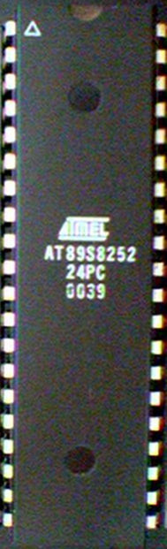
Contents:
Introduction
8051 Architecture
Addressing Modes
Timers

Slide 3

An example for CISC Processor.
Harvard Architecture
Collection of 8 and 16 bit registers and 8 bit memory locations.
External Memory can be interfaced.

Slide 4

Pin Description of the 8051
P1.0
1
40
Vcc
P1.1
2
39
P0.0(AD0)
P1.2
3
38
P0.1(AD1)
P1.3
4
8051
37
P0.2(AD2)
P1.4
5
36
P0.3(AD3)
P1.5
6
35
P0.4(AD4)
P1.6
7
34
P0.5(AD5)
P1.7
8
33
P0.6(AD6)
RST
9
32
P0.7(AD7)
(RXD)P3.0
10
31
EA/VPP
(TXD)P3.1
11
30
ALE/PROG
(INT0)P3.2
12
29
PSEN
(INT1)P3.3
13
28
P2.7(A15)
(T0)P3.4
14
27
P2.6(A14)
(T1)P3.5
15
26
P2.5(A13)
(WR)P3.6
16
25
P2.4(A12)
(RD)P3.7
17
24
P2.3(A11)
XTAL2
18
23
P2.2(A10)
XTAL1
19
22
P2.1(A9)
GND
20
21
P2.0(A8)


Slide 5
Pins of 8051（1/4）
Vcc（pin 40）：
  Vcc provides supply voltage to the chip.
  The voltage source is +5V.
GND（pin 20）：ground
XTAL1 and XTAL2（pins 19,18）：
  These 2 pins provide external clock.

Slide 6
Pins of 8051（2/4）
RST（pin 9）：reset
  It is an input pin and is active high（normally low）.
    Upon applying a high pulse to RST, the microcontroller will reset and all values in registers will be lost.

Slide 7
Pins of 8051（3/4）
/EA（pin 31）：external access
  The /EA pin is connected to GND to indicate the code is stored externally.
  For 8051, /EA pin is connected to Vcc.
  “/” means active low.
/PSEN（pin 29）：program store enable
  This is an output pin and is connected to the OE pin of the ROM

Slide 8
Pins of 8051（4/4）
ALE（pin 30）：address latch enable
  It is an output pin and is active high.
  8051 port 0 provides both address and data.
  The ALE pin is used for de-multiplexing the address and data by connecting to the G pin of the 74LS373 latch.
I/O port pins
  The four ports P0, P1, P2, and P3.
  Each port uses 8 pins.
  All I/O pins are bi-directional.

Slide 9
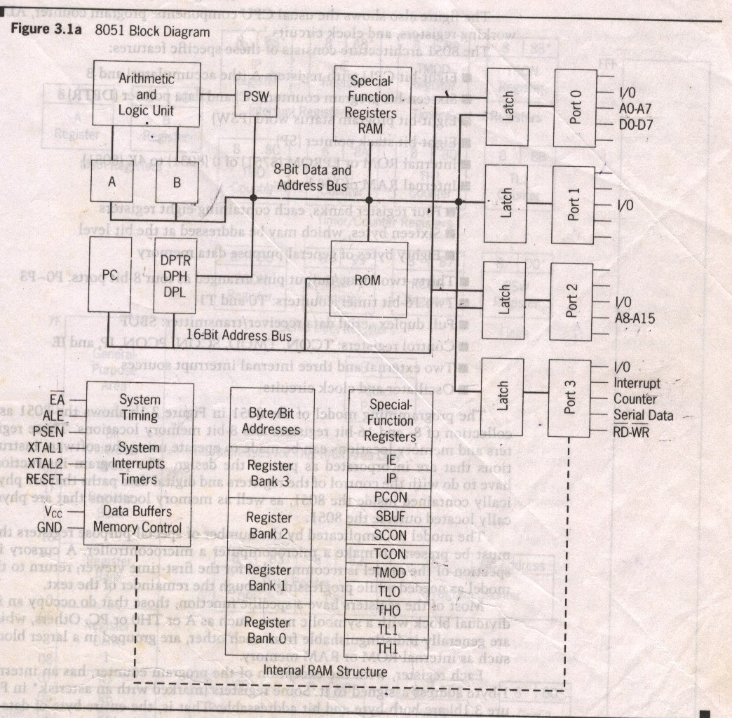
Block Diagram

Slide 10
Internal ROM and RAM
I/O Ports with programmable Pins
ALU
Working Registers
Clock Circuits
Timers and Counters
Serial Data Communication.

Slide 11
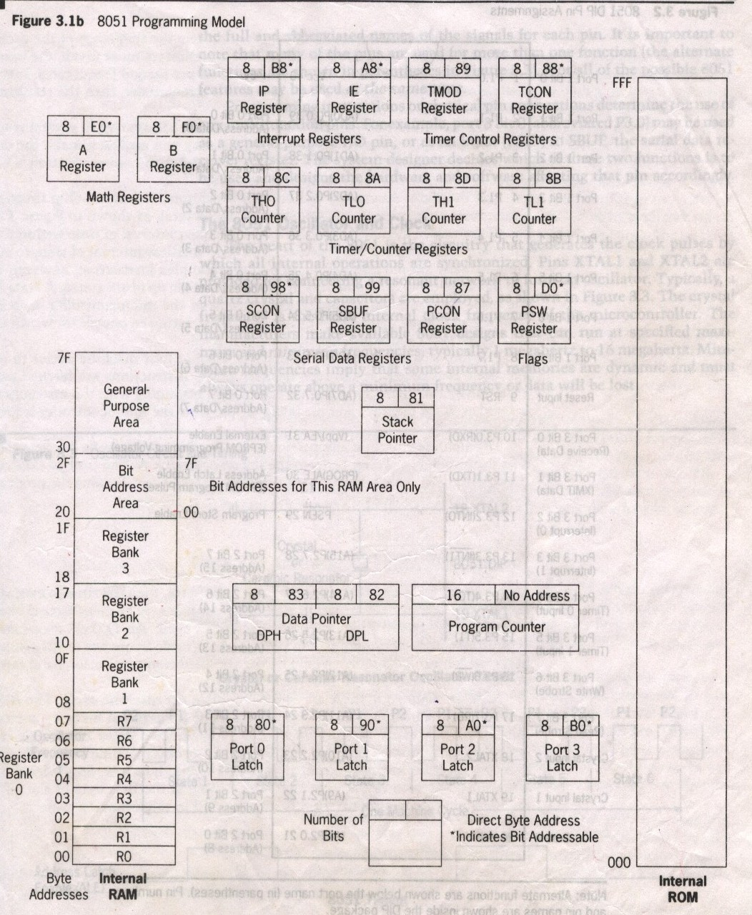
8051 Programming Model

Slide 12
Specific Features
8 bit cpu with registers A and B
16 bit PC and DPTR(data pointer).
8 bit program status word(PSW)
8 bit Stack Pointer
4K Internal ROM
128bytes Internal RAM
- →4 register banks each having 8 registers
→16 bytes,which may be addressed at the bit level.
→80 bytes of general purpose data memory

Slide 13
Specific Features
32 i/o pins arranged as 4 8 bit ports:P0 to P3
Two 16 bit timer/counters:T0 and T1
Full duplex serial data receiver/transmitter
Control registers:TCON,TMOD,SCON,PCON,IP and IE
Two external and Three internal interrupt sources.
Oscillator and Clock Circuits.

Slide 14
Pins of I/O Port
The 8051 has four I/O ports
  Port 0 （pins 32-39）：P0（P0.0～P0.7）
  Port 1（pins 1-8） ：P1（P1.0～P1.7）
  Port 2（pins 21-28）：P2（P2.0～P2.7）
  Port 3（pins 10-17）：P3（P3.0～P3.7）
  Each port has 8 pins.
    Named P0.X （X=0,1,...,7）, P1.X, P2.X, P3.X
    Ex：P0.0 is the bit 0（LSB）of P0
    Ex：P0.7 is the bit 7（MSB）of P0
    These 8 bits form a byte.
Each port can be used as input or output (bi-direction).

Notes:
Program is to read data from P0 and then send data to P1

Slide 15
Program Counter & Data Pointer
They are both 16 bit registers.
Each is to hold the address of a byte in memory
PC contains the address of the next instruction to be executed.
DPTR is made up of two 8 bit register DPH and DPL;
DPTR contains the address of internal & external code and data that has to be accessed.

Slide 16
A and B CPU registers
Totally 34 general purpose registers or working registers.
Two of these A and B hold results of many instructions, particularly math and logical operations of 8051 cpu.
The other 32 are in four banks,B0 – B3 of eight registers each.
A(accumulator) is used for addition,subtraction,mul,div,boolean bit manipulation and for data transfers.
But B register can only be used for mul and div operations.

Slide 17
8051 Flag bits and the PSW register
PSW Register
CY
AC
F0
RS1
RS0
OV
--
P
CY PSW.7 Carry flag
AC PSW.6 Auxiliary carry flag
-- PSW.5 Available to the user for general purpose
RS1 PSW.4 Register Bank selector bit 1
RS0 PSW.3 Register Bank selector bit 0
OV PSW.2 Overflow flag
-- PSW.1 User define bit
P PSW.0 Parity flag Set/Reset odd/even parity
RS1 RS0 Register Bank Address
0 0 0 00H-07H
0 1 1 08H-0FH
1 0 2 10H-17H
1 1 3 18H-1FH

Slide 18
Two flag bits are stored in PCON(Power control) registers also.
They are the GF1 (3RD) and GF0(2nd) bits
They are general purpose user flag bit 1 and 0 respectively
They can be set or cleared by the program
For more details of PCON, refer fig 3.13 in text book.

Slide 19
Memory Organization
RAM memory space allocation in the 8051
7FH
Scratch pad RAM
30H
2FH
Bit-Addressable RAM
20H
1FH
Register Bank 3
18H
17H
Register Bank 2
10H
0FH
(Stack) Register Bank 1
08H
07H
Register Bank 0
00H

Slide 20
Stack in the 8051
The register used to access the stack is called SP (stack pointer) register.
The stack pointer in the 8051 is only 8 bits wide, which means that it can take value 00 to FFH. When 8051 powered up, the SP register contains value 07.
7FH
Scratch pad RAM
30H
2FH
Bit-Addressable RAM
20H
1FH
Register Bank 3
18H
17H
Register Bank 2
10H
0FH
(Stack) Register Bank 1
08H
07H
Register Bank 0
00H

Slide 21
Special Function Registers
Name | Function | Name | Function
A | Accumulator | SBUF | Serial Port data buffer
B | Arithmetic | SP | Stack Pointer
DPH | Addressing Ext Memory | TMOD | Timer/Counter mode cntrl
DPL | Addressing Ext Memory | TCON | Timer/Counter cntrl
IE | Interrupt enable | TL0 | Timer0 lower byte
IP | Interrupt Priority | TH0 | Timer0 higher byte
P0 | I/O Port Latch | TL1 | Timer1 lower byte
P1 | I/O Port Latch | TH1 | Timer1 higher byte
P2 | I/O Port Latch
P3 | I/O Port Latch
PCON | Power Control
PSW | Pgm Status Word
SCON | Serial PortCntrl

Slide 22
Port 0（pins 32-39）
I/O Port Programming
When connecting an 8051 to an external memory, the 8051 uses ports to send addresses and read instructions.
  16-bit address：P0 provides both address A0-A7, P2 provides address A8-A15.
  Also, P0 provides data lines D0-D7.
When P0 is used for address/data multiplexing, it is connected to the 74LS373 to latch the address.
Notes:
Open drain is a term used for MOS chips in the same way that open collector is used for TTL chips.

Slide 23
Port 1（pins 1-8）

Port 1 is denoted by P1.
  P1.0 ~ P1.7
  P1 as an output port (i.e., write CPU data to the external pin)
  P1 as an input port (i.e., read pin data into CPU bus)

Slide 24
ALE Pin
The ALE pin is used for de-multiplexing the address and data by connecting to the G pin of the 74LS373 latch.
  When ALE=0, P0 provides data D0-D7.
  When ALE=1, P0 provides address A0-A7.
  The reason is to allow P0 to multiplex address and data.

Slide 25
Port 3（pins 10-17）
Although port 3 is configured as an output port upon reset, this is not the way it is most commonly used.
Port 3 has the additional function of providing signals.
  Serial communications signal：RxD, TxD
  External interrupt：/INT0, /INT1
  Timer/counter：T0, T1
  External memory accesses ：/WR, /RD

Slide 26
Port 3 Alternate Functions
P3 Bit
Function
Pin
P3.0
RxD
10
P3.1
TxD
11
P3.2
INT0
12
P3.3
INT1
13
P3.4
T0
14
P3.5
T1
15
P3.6
WR
16
P3.7
RD
17


Slide 27
Addressing Modes
The way in which the instruction is specified.
Immediate
Register
Direct
Register Indirect
Indexed

Slide 28
Immediate Addressing Mode
Immediate Data is specified in the instruction itself
Egs:
MOV A,#65H
MOV A,#’A’
MOV R6,#65H
MOV DPTR,#2343H
MOV P1,#65H

Slide 29
Register Addressing Mode
MOV Rn, A ;n=0,..,7
ADD A, Rn
MOV DPL, R6
MOV DPTR, A
MOV Rm, Rn

Slide 30
Direct Addressing Mode
Although the entire of 128 bytes of RAM can be accessed using direct addressing mode, it is most often used to access RAM loc. 30 – 7FH.
MOV R0, 40H
MOV 56H, A
MOV A, 4 ; ≡ MOV A, R4
MOV 6, 2 ; copy R2 to R6
; MOV R6,R2 is invalid !

Slide 31
Register Indirect Addressing Mode
In this mode, register is used as a pointer to the data.
MOV A,@Ri
; move content of RAM loc. Where address is held by Ri into A
( i=0 or 1 )
MOV @R1,B
In other word, the content of register R0 or R1 is sources or target in MOV, ADD and SUBB insructions.
jump

Slide 32
Indexed Addressing Mode And On-Chip ROM Access
This mode is widely used in accessing data elements of look-up table entries located in the program (code) space ROM at the 8051
MOVC A,@A+DPTR
A= content of address A +DPTR from ROM
Note:
Because the data elements are stored in the program (code ) space ROM of the 8051, it uses the instruction MOVC instead of MOV. The “C” means code.

